Slide 1
Microsoft 365 Platform: New opportunities for engagement

Slide 2


The world’s productivity service
Office 365
Windows 10
Microsoft Graph
Apps & Devices
Enterprise Mobility + Security
Connected Experiences
Integrated Workflow
Intelligent Security
Modern Office & Windows
Teams
Identity
Teams & Stream
Power Platform
Threat Protection
Modern Devices
SharePoint
Information Protection

Slide 3
Microsoft Graph
Apps & Devices

Slide 4
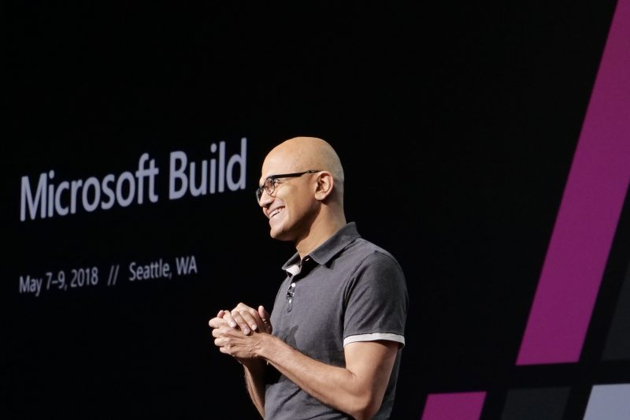
We're focused on two massive platform opportunities, one, Microsoft Azure, the other Microsoft 365.
Microsoft 365 is the coming together of Windows and Office to build this multi-device, multi-sense experience, service, and platform. And it puts people at the center, versus devices at the center.
– Satya Nadella

Slide 5
Platform
Microsoft Office & SharePoint
Microsoft Teams
Intelligent Edge
Web
Native/Hybrid
Microsoft Graph
Intelligent Cloud
Microsoft Identity

Slide 7
Platform
6
Microsoft Office & SharePoint
5
Microsoft Teams
Intelligent Edge
4
Web
Microsoft Edge
3
Native/Hybrid
Microsoft Windows
2
Microsoft Graph
Intelligent Cloud
1
Microsoft Identity

Slide 8
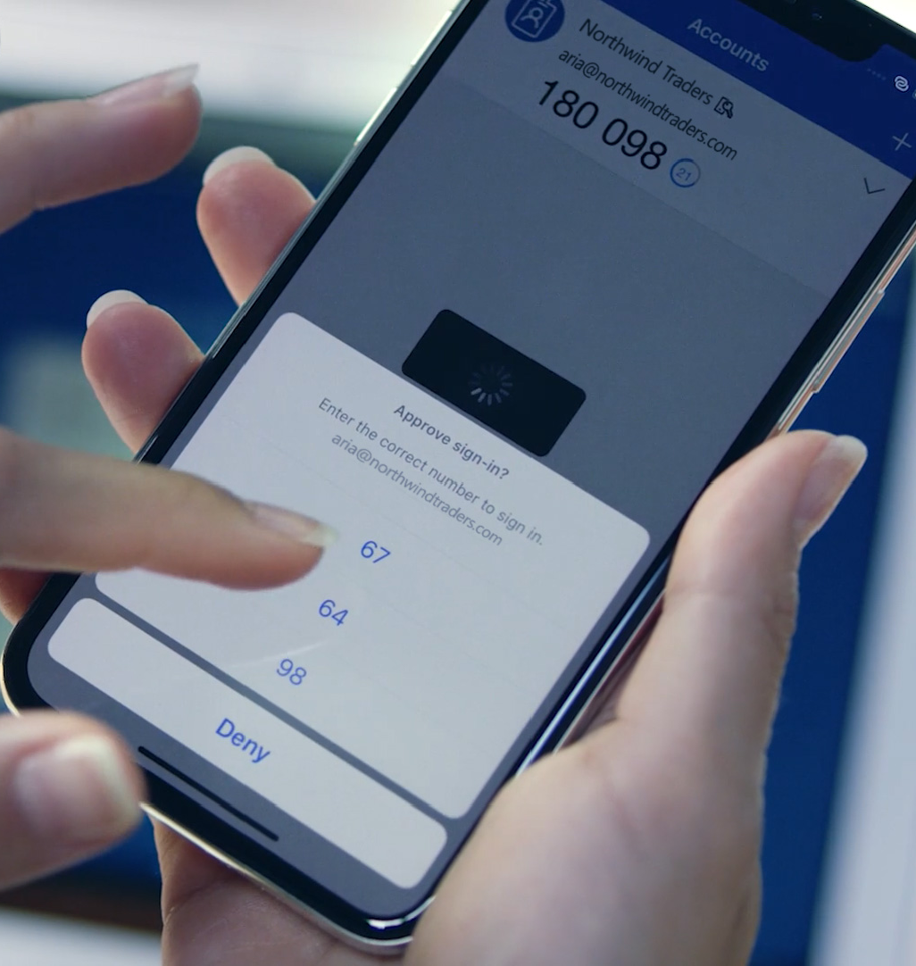

1
2
3
4
5
6
Microsoft Identity
Microsoft Graph
Microsoft Windows
Microsoft Edge
Microsoft Teams
Microsoft Office & SharePoint
Microsoft Identity
Anchor for cross-platform experiences
Over 1 billion users a month across work, school, and personal
Seamless authentication experiences for 1st and 3rd party
Enterprise grade security and management

Slide 9
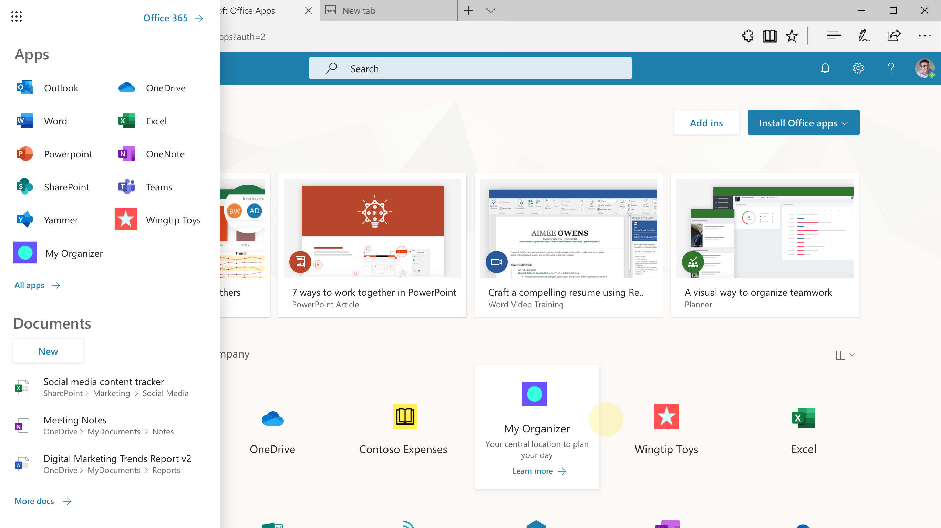
1
2
3
4
5
6
Microsoft Identity
Microsoft Graph
Microsoft Windows
Microsoft Edge
Microsoft Teams
Microsoft Office & SharePoint
Microsoft Identity
Advanced security
Go passwordless
Comply with IT policies
Improved app discovery

Slide 10

1
2
3
4
5
6
Microsoft Identity
Microsoft Graph
Microsoft Windows
Microsoft Edge
Microsoft Teams
Microsoft Office & SharePoint
Microsoft Identity
Over 1 million active 3rd party applications
Unified app registrations experience
Microsoft Authentication Libraries
OpenID Certified
Access to Microsoft resources and data

Slide 11



1
2
3
4
5
6
Microsoft Identity
Microsoft Graph
Microsoft Windows
Microsoft Edge
Microsoft Teams
Microsoft Office & SharePoint
Microsoft Graph
Microsoft Graph Data and Services
Core schema for productivity
Customers are always in control of their data
More than 18.5T nodes across work, life, and school
Services for search, analytics, natural language, and more

Slide 12
1
2
3
4
5
6
Microsoft Identity
Microsoft Graph
Microsoft Windows
Microsoft Edge
Microsoft Teams
Microsoft Office & SharePoint
Interactive apps
REST APIs and Webhooks
Microsoft Graph
1
data
connect
Microsoft Graph productivity data
Data From Your app

Slide 13
1
2
3
4
5
6
Microsoft Identity
Microsoft Graph
Microsoft Windows
Microsoft Edge
Microsoft Teams
Microsoft Office & SharePoint
Interactive apps
Analytics apps
REST APIs and Webhooks
Microsoft Graph data connect
1
3
Microsoft Graph
data
connect
Services
Connectors
2
Microsoft Graph productivity data
Data from your app

Slide 14
1
2
3
4
5
6
Microsoft Identity
Microsoft Graph
Microsoft Windows
Microsoft Edge
Microsoft Teams
Microsoft Office & SharePoint
Conversational AI
Bot Framework
Microsoft Graph
Microsoft Adaptive Cards
Microsoft Search
Microsoft Graph data connect
data
connect
Services
Fluid
Framework
Azure Cognitive Services
Bot Framework

Slide 15




























1
2
3
4
5
6
Microsoft Identity
Microsoft Graph
Microsoft Windows
Microsoft Edge
Microsoft Teams
Microsoft Office & SharePoint
Bot Framework
Microsoft Graph
Services
Most comprehensive experience for building bots or virtual assistants
Bot Framework
Build your own Virtual Assistant
Complete control of your own branded user experience and your own data
Open-sourced solution with Graph-powered skills, and skill template

Slide 16

Platform
6
Microsoft Office & SharePoint
5
Microsoft Teams
Intelligent Edge
4
Web
Microsoft Edge
3
Native/Hybrid
Microsoft Windows
2
Microsoft Graph
Intelligent Cloud
1
Microsoft Identity

Slide 17
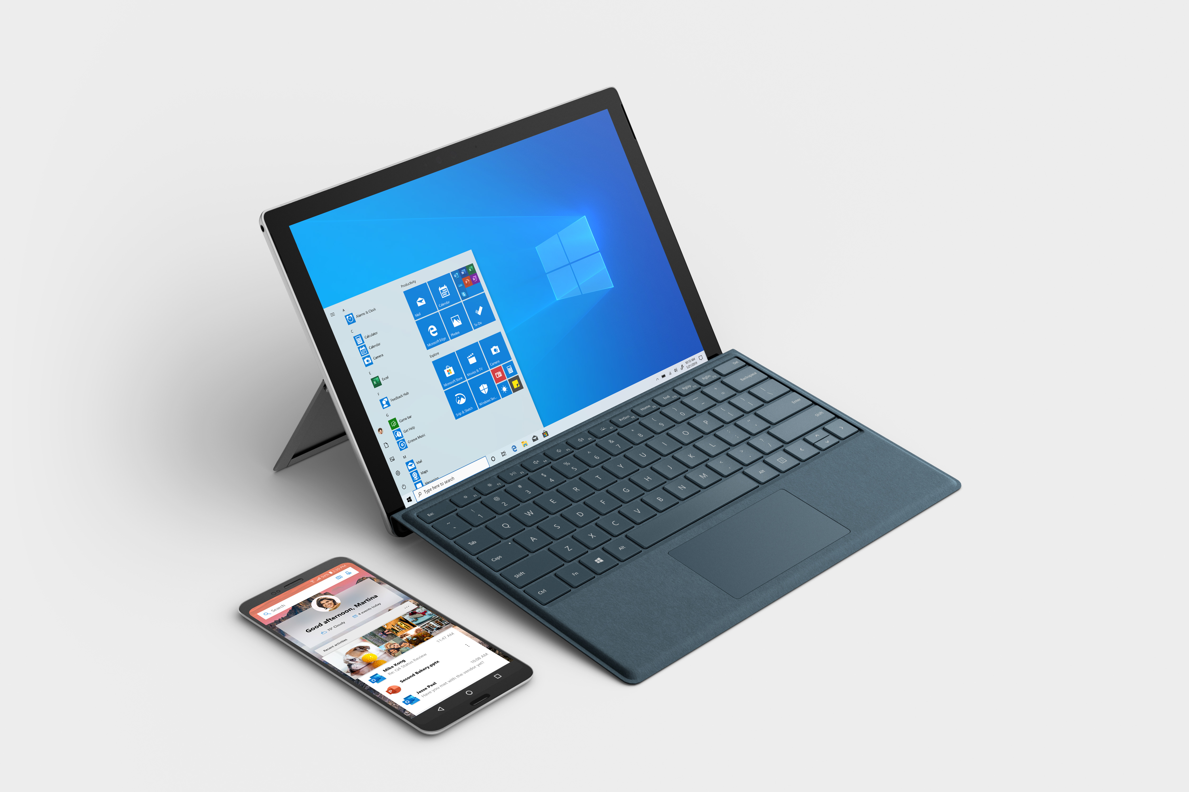
1
2
3
4
5
6
Microsoft Identity
Microsoft Graph
Microsoft Windows
Microsoft Edge
Microsoft Teams
Microsoft Office & SharePoint
Extending Windows applications
For device-optimized apps
Windows powers a breadth of modern devices
Embracing all frameworks
Expanding the reach of your code
Share code with other ecosystems

Slide 18
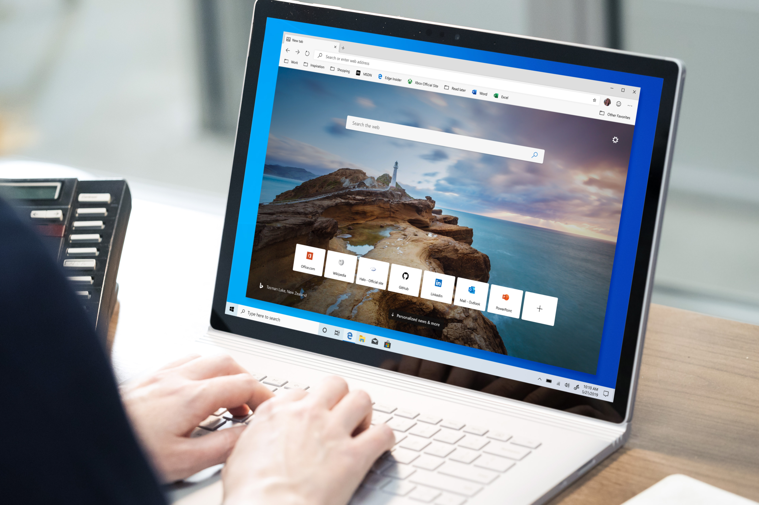
1
2
3
4
5
6
Microsoft Identity
Microsoft Graph
Microsoft Windows
Microsoft Edge
Microsoft Teams
Microsoft Office & SharePoint
Building Web Apps
For consistent, standards-based experiences across platforms
One browser for all your web experiences
End to end web development
Contributing back to make the whole web better

Slide 19
1
2
3
4
5
6
Microsoft Identity
Microsoft Graph
Microsoft Windows
Microsoft Edge
Microsoft Teams
Microsoft Office & SharePoint
Extending Windows apps
Powered by Windows
Connected to the Microsoft Graph
Expanding the reach of your code
Building Web apps
The next version of Microsoft Edge
IE mode and standards-based
Terminal, WSL2 with native Docker

Slide 20
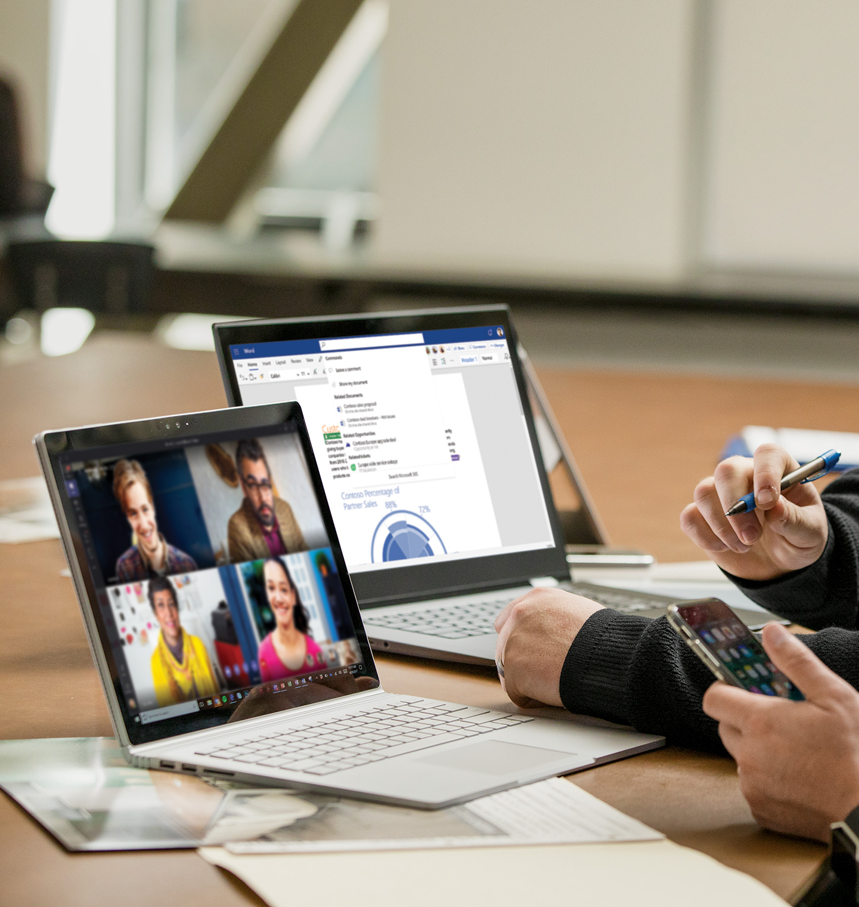
1
2
3
4
5
6
Microsoft Identity
Microsoft Graph
Microsoft Windows
Microsoft Edge
Microsoft Teams
Microsoft Office & SharePoint
Building on Teams
Powering a new way to work in a wide variety of companies
More than just chat – a hub for all of a team’s apps
Connect teams and business processes
Enables industry and role-based applications

Slide 21

1
2
3
4
5
6
Microsoft Identity
Microsoft Graph
Microsoft Windows
Microsoft Edge
Microsoft Teams
Microsoft Office & SharePoint
Office and SharePoint
For business process in the context of familiar tools
SharePoint is the home for content for Microsoft 365
Flexible business processes with Flow and PowerApps
Deeply extend Office apps with the web

Slide 22


Engage with Microsoft
Change conversations with bots and compose extensions
Microsoft Teams
Streamline workflows with an adaptive card in e-mail
Microsoft Outlook
Boost creativity with an add-in
Word, Excel and PowerPoint
Harness organizational data anywhere
Microsoft Graph
Create engaging user experiences
Windows 10
Deliver key information and tools to teams with a web part
SharePoint and Microsoft Teams
Add authentication and sign-in to your application
Microsoft Identity

